Slide 1
Digital Portfolio
STUDENT NAME: Lakshmi A
REGISTER NO AND NMID: 0A6E3D0597AD9EDB4154029B99B8196F
DEPARTMENT: BCA ( computer application)
COLLEGE: Vidhya Sagar women's college Madras University

Slide 2
PROJECT TITLE
Student portfolio

Slide 3


AGENDA
Problem Statement
Project Overview
End Users
Tools and Technologies
Portfolio design and Layout
Features and Functionality
Results and Screenshots
Conclusion
Github Link
3/21/2024 Annual Review

Slide 4

PROBLEM STATEMENT
Students often face challenges in presenting their achievements, skills, and projects in a professional and organized manner. Traditional resumes and paper-based portfolios are limited, outdated, and less interactive. There is a need for a digital student portfolio that allows easy access, better presentation, and effective showcasing of talents to teachers, peers, and potential employers.

Slide 5

PROJECT OVERVIEW
This project focuses on developing a digital student portfolio using HTML, CSS, and JavaScript. It will include sections such as profile, education, skills, projects, resume, and contact details. The portfolio aims to provide a professional platform for students to showcase their achievements, talents, and work, making it easier to share with teachers, peers, and potential employers.

Slide 6

WHO ARE THE END USERS?
Students: They use for their future opportunities and a evidence for their work. Employers: A company review their skills and projects for hiring decisions.

Slide 7

TOOLS AND TECHNIQUES
HTML gave structure to my website and helped organize the content. CSS added style, colors, and an elegant layout. JavaScript added smooth interactions that make the website engaging.
Together, these technologies transformed a simple idea into a stylish digital portfolio.

Slide 8
POTFOLIO DESIGN AND LAYOUT
Home/About Me – Introduction and personal details. Projects – Work and projects completed. Skills – Abilities and technical strengths. Contact – Ways to connect. Responsive Layout – Works well on both mobile and desktop views
8

Slide 9
FEATURES AND FUNCTIONALITY
Navigation bar with smooth scrolling – Easy movement between sections. Project showcase – Display projects with images and details. Interactive elements – Hover effects and animations for better user experience. Contact form with validation – Ensures correct input before submission. Responsive design – Works well on all devices (mobile, tablet, desktop)

Slide 10
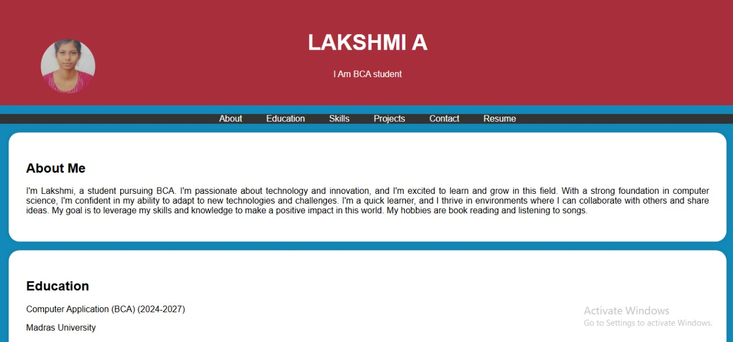

RESULTS AND SCREENSHOTS
3/21/2024 Annual Review
10

Slide 11
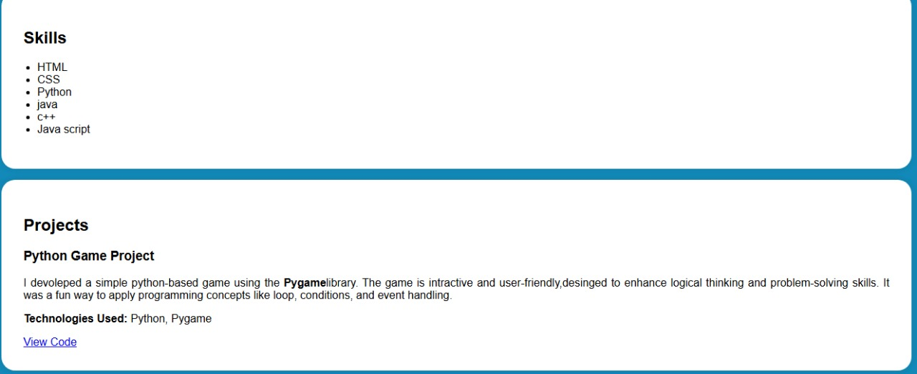

Slide 12
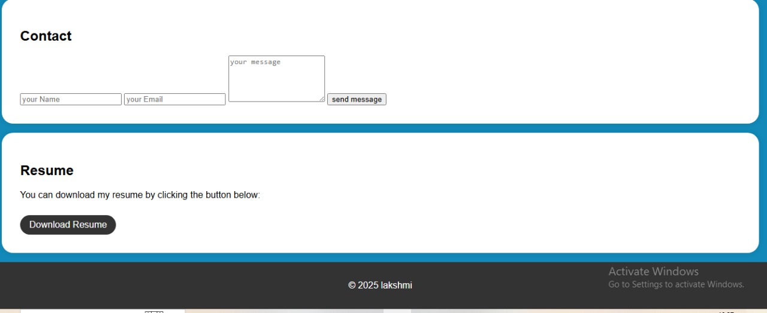

Slide 13
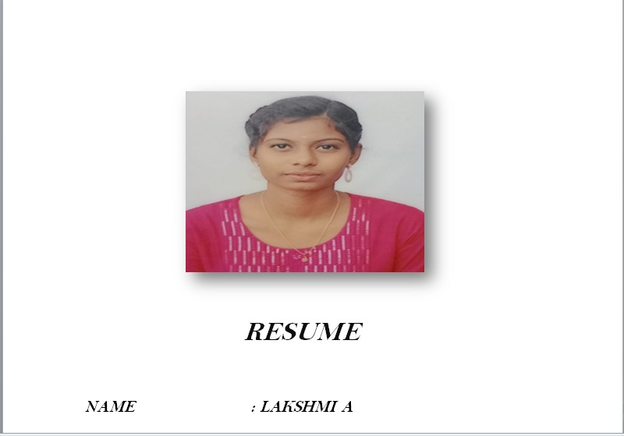

Slide 14
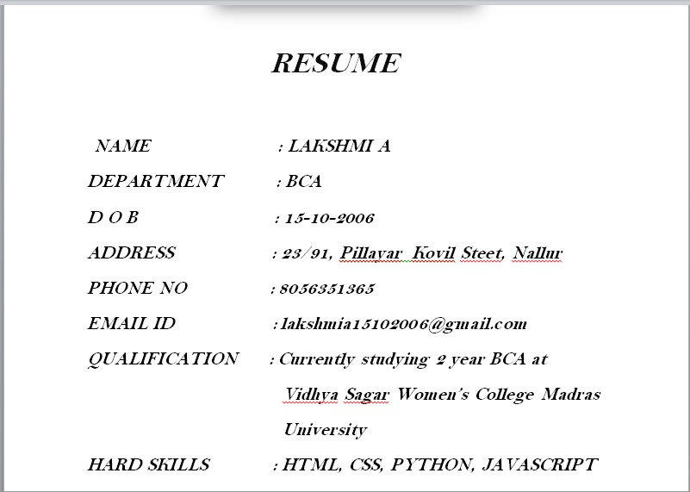

Slide 15
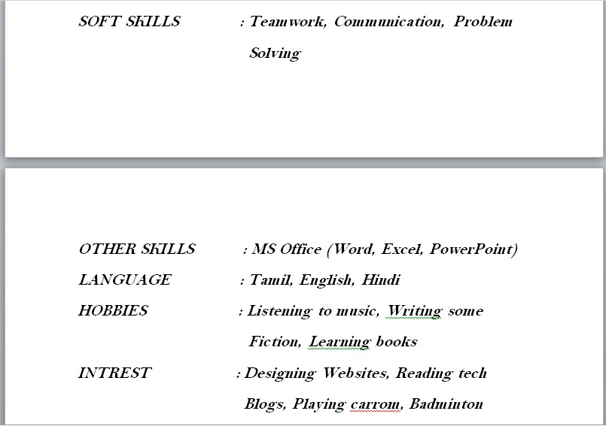

Slide 16
CONCLUSION
This portfolio highlights my skills, achievements, and projects in a professional way. It serves as a personal platform to showcase my work, reflect my growth, and connect with future opportunities. Additionally, it shows my creativity and dedication towards learning. It will help me share my journey with teachers, friends, and future employers. Overall, this portfolio is a step toward building my career and improving myself.
16

